Slide 1

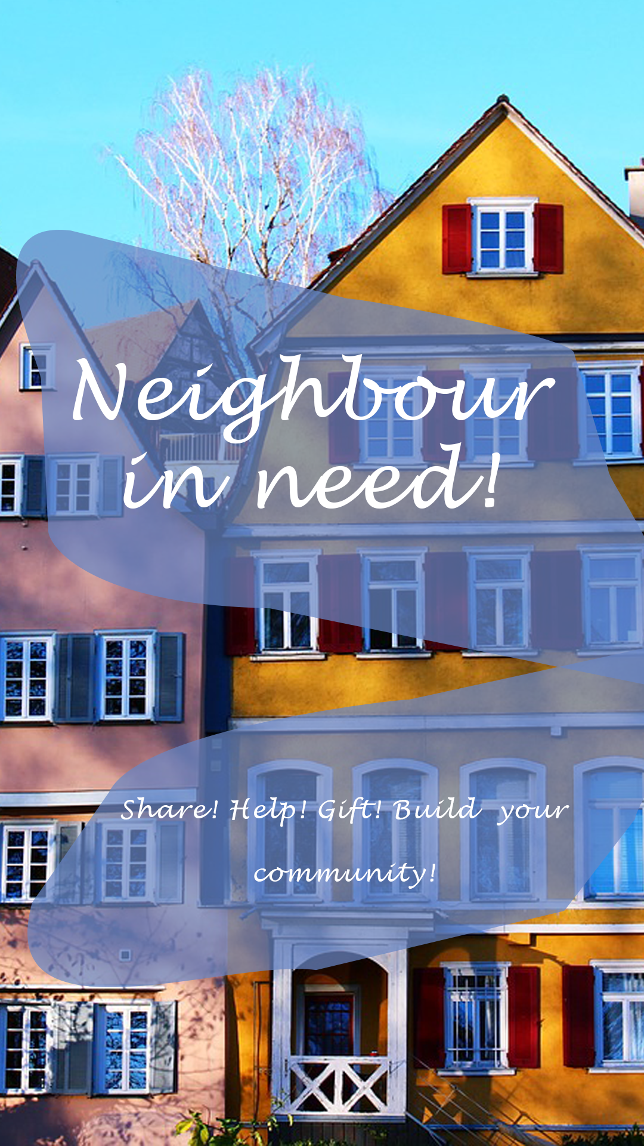
Mobile Computing
SS 2020 Neighbour in Need Fanni Marosi, 764345 Ebru Özcelik, 764249

Slide 2
Agenda
Vision
Personas
Functional Requirements
Non-Functional Requirements
Mock-Ups

Slide 3
Vision
Personas
Functional Requirements
Non-Functional
Requirements
Mock-Ups
For communality, for the neighbourhood
To help/share/gift and build a community
Users can:
Register
Create and search for advertisements
Gift something
Borrow/lend sth.
Offer help (e.g. going to the supermarket)

Slide 4
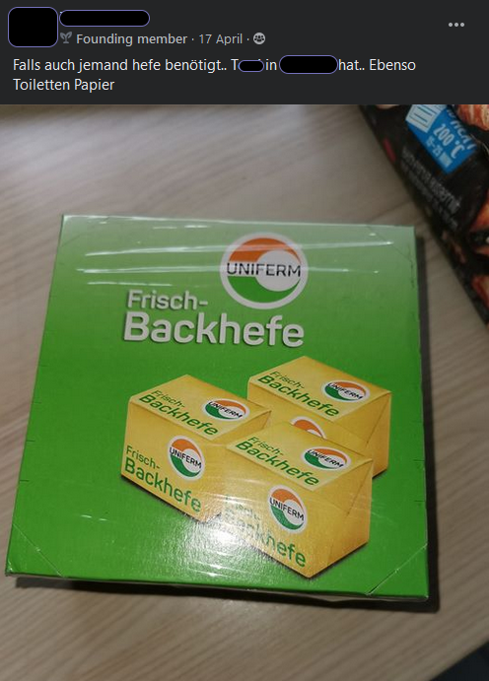
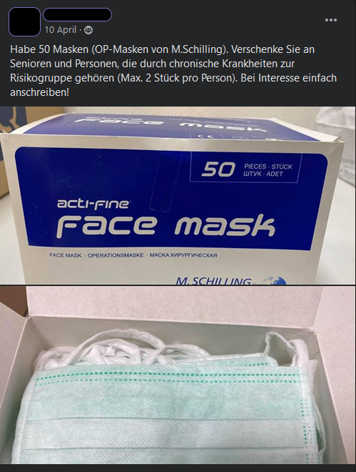
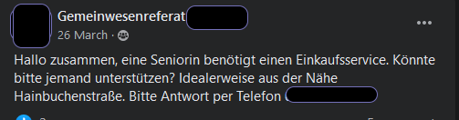
Vision
Personas
Functional Requirements
Non-Functional
Requirements
Mock-Ups

Slide 5
Vision
Personas
Functional Requirements
Non-Functional
Requirements
Mock-Ups
Our user group is very heterogeneous concerning:
Age
Gender
Job
Everybody (except children) could use the application

Slide 6
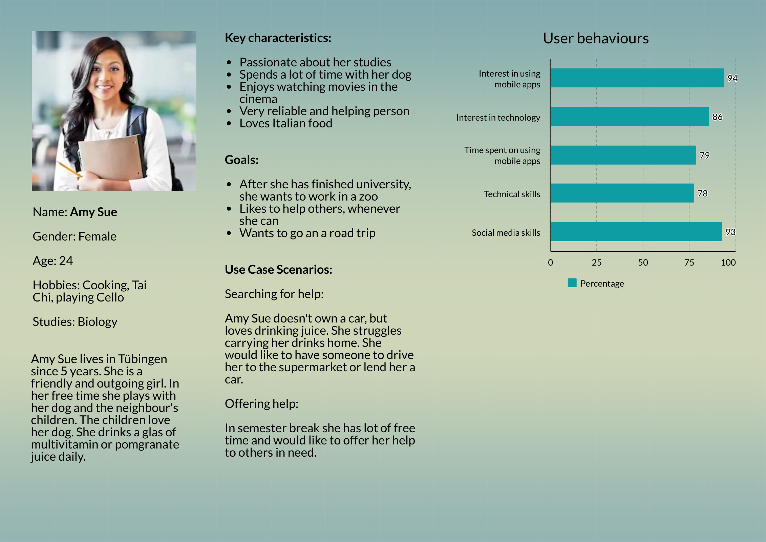

Slide 7
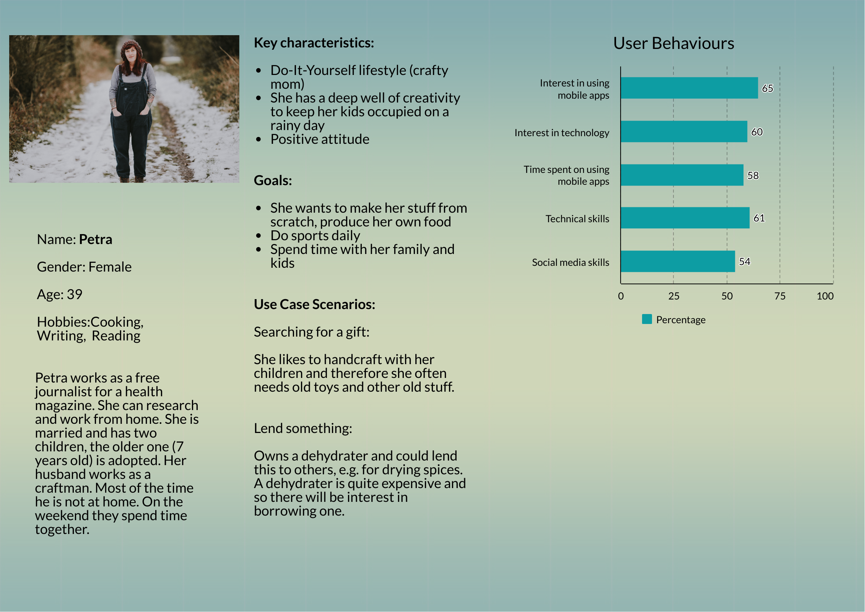

Slide 8
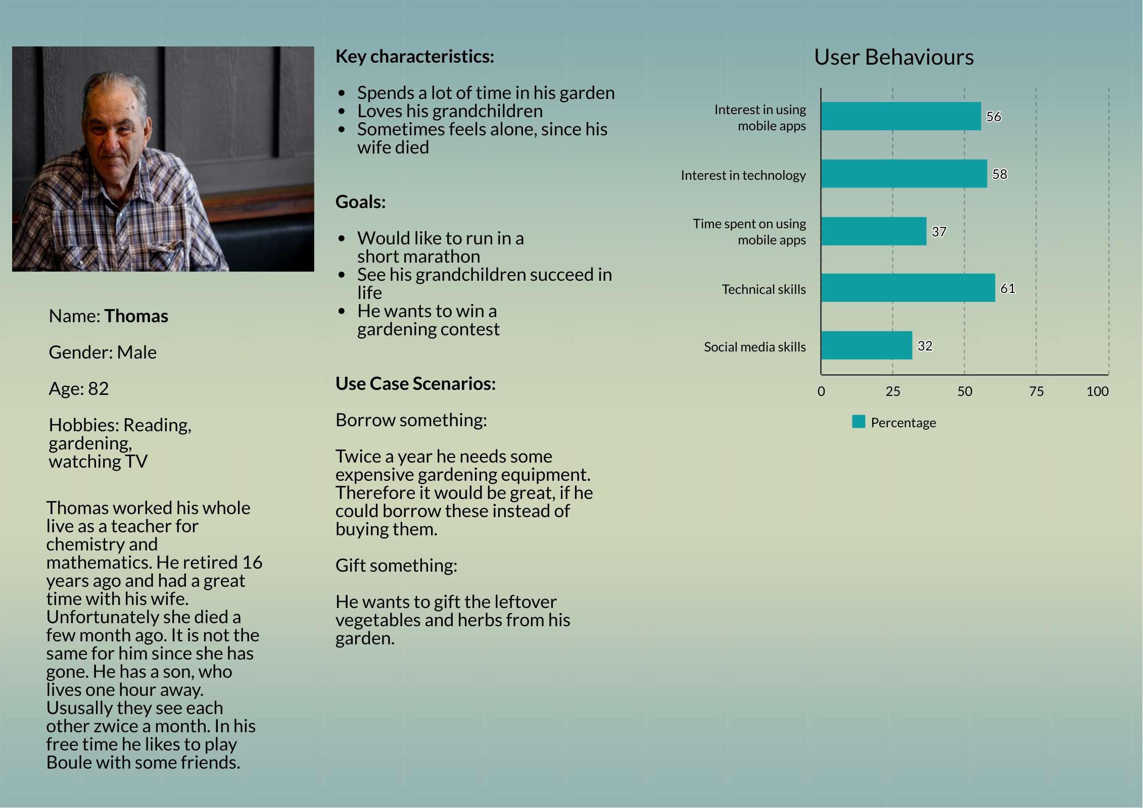

Slide 9
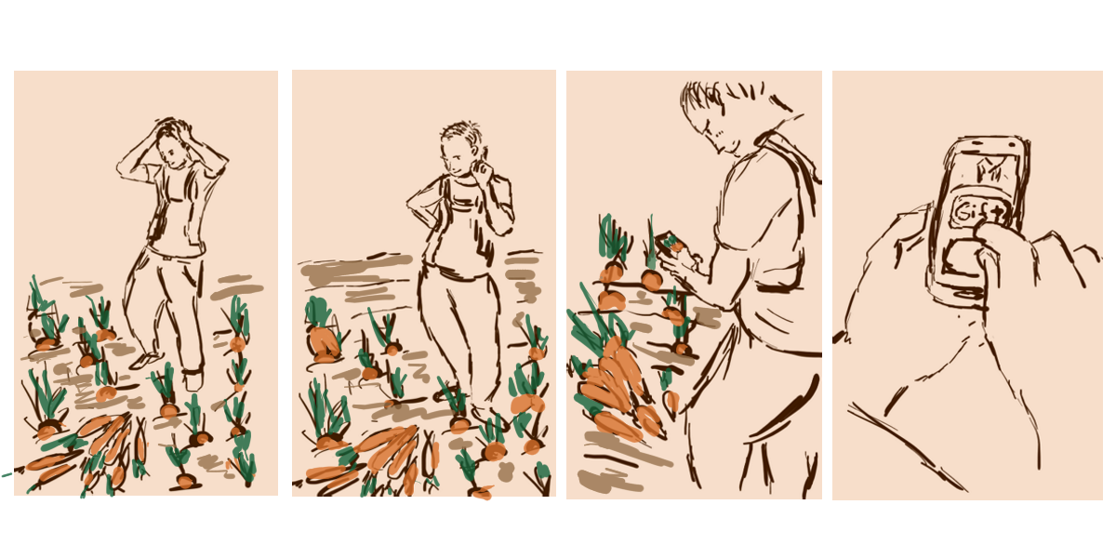

Slide 10
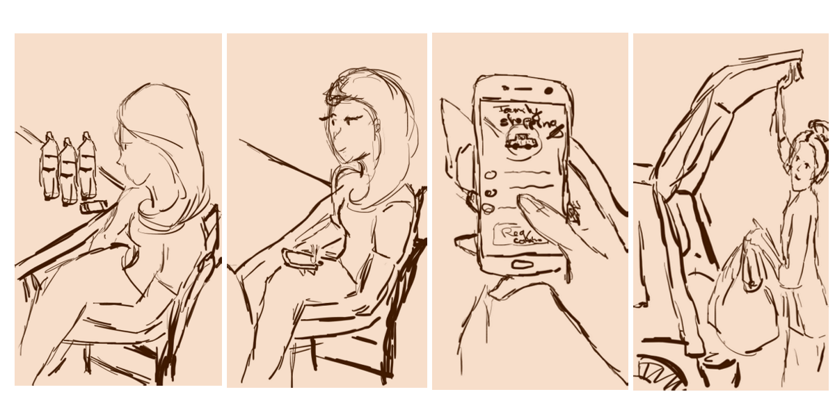

Slide 11
Vision
Personas
Functional Requirements
Non-Functional
Requirements
Mock-Ups

Slide 12
Functional Requirement | Level of importance
Create an account | 5
Login | 5
Create an advertisement | 5
Search for an advertisement | 5
Pick one advertisement from the list of results | 4
Request personal information | 4
Account management/settings | 3
Edit personal information | 3
Advertisement management „Offer“ | 3
Advertisement management „Borrow“ | 3
Rate other users | 2
Sort result list | 1
1 = not that important 2 = nice to have 3 = quite important 4 = important 5 = main or basic functionality

Slide 13
Vision
Personas
Functional Requirements
Non-Functional
Requirements
Mock-Ups

Slide 14
Non-functional Requirement | Description
Performance | Not longer than 3 seconds to load a screen, reduce network usage and computing to save battery-life
Portability | Should run on different Android systems
Screen Adaption | App should scale according the target’s screen size
Useability | Self-explanatory symbols, interaction easy to adapt to, used colours are limited to an amount of four
Security | Encrypt data and only ask for information, which is necessarily needed, constraint the input fields, user must pass the correct data type and the correct format within the correct range to pass the login/register screen
Reliability | System should reliable to perform the function the user asked for, feedback to the user performing actions, e.g. if you request contact exchange from another user
Accessibility | Appropriate button size, so that everybody can easily use them avoid red and green together
Availability | Application should be downloadable in the Google Play Store, where users can easily access and install it

Slide 15
Vision
Personas
Functional Requirements
Non-Functional
Requirements
Mock-Ups

Slide 16
UI Design | Description
Bottom navigation | They are easy to reach with your thumb while holding your phone, but also because they are always visible, allowing for easy navigation and clear guidance.
Microinteractions | Tab bar active animation.
Colorful | Blazing colors promote positivity and therefore support trust and optimism in the app.
Whitespace | Usage of more whitespace between buttons and fields.
Round and abstract shapes | Round corners and abstract buttons.
Typography | For a while now, the use of handwritten script fonts has been on the rise.
Color | Color scheme should not include more than 4 colours.
Words | Use text in meaningful way that important words get noticed and read.
Icons | Always be consistent with the words. Use icons, that are most widely used.

Slide 17

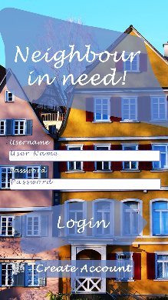
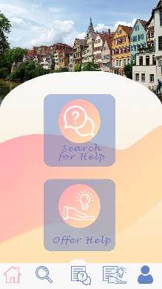
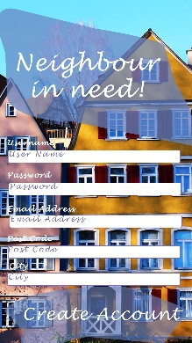
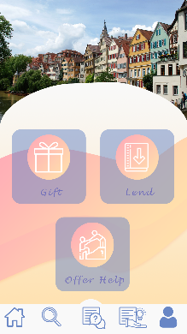

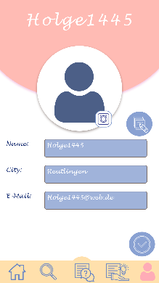

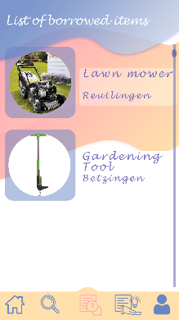
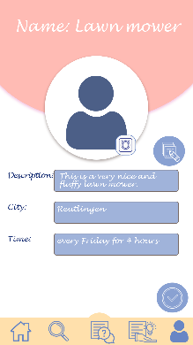
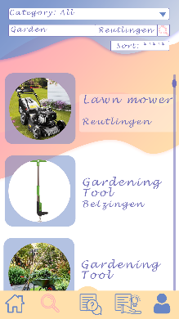
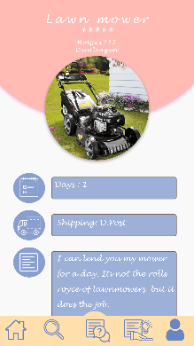

Slide 18
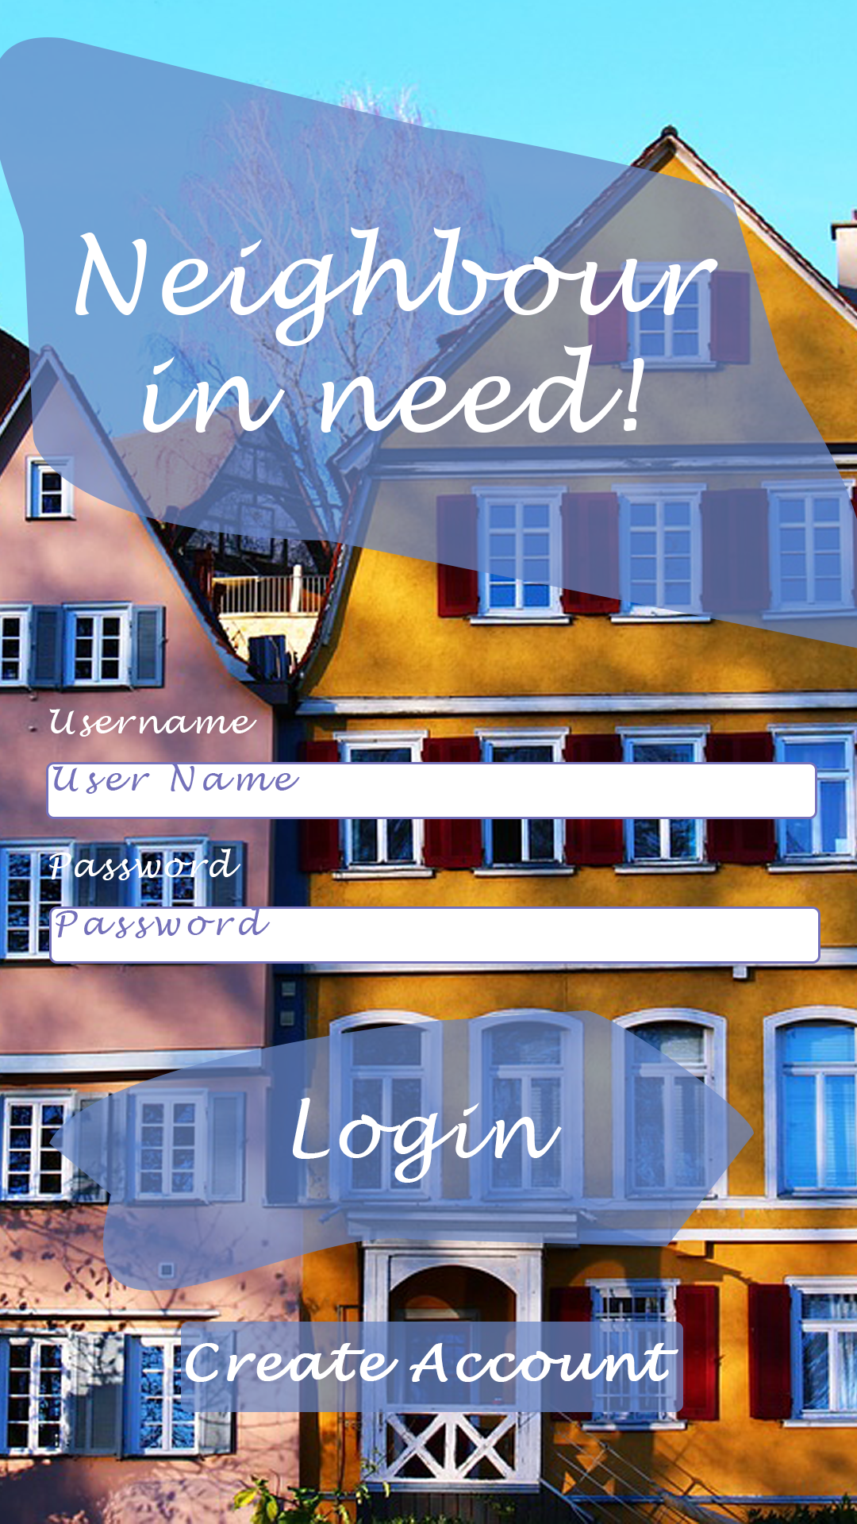
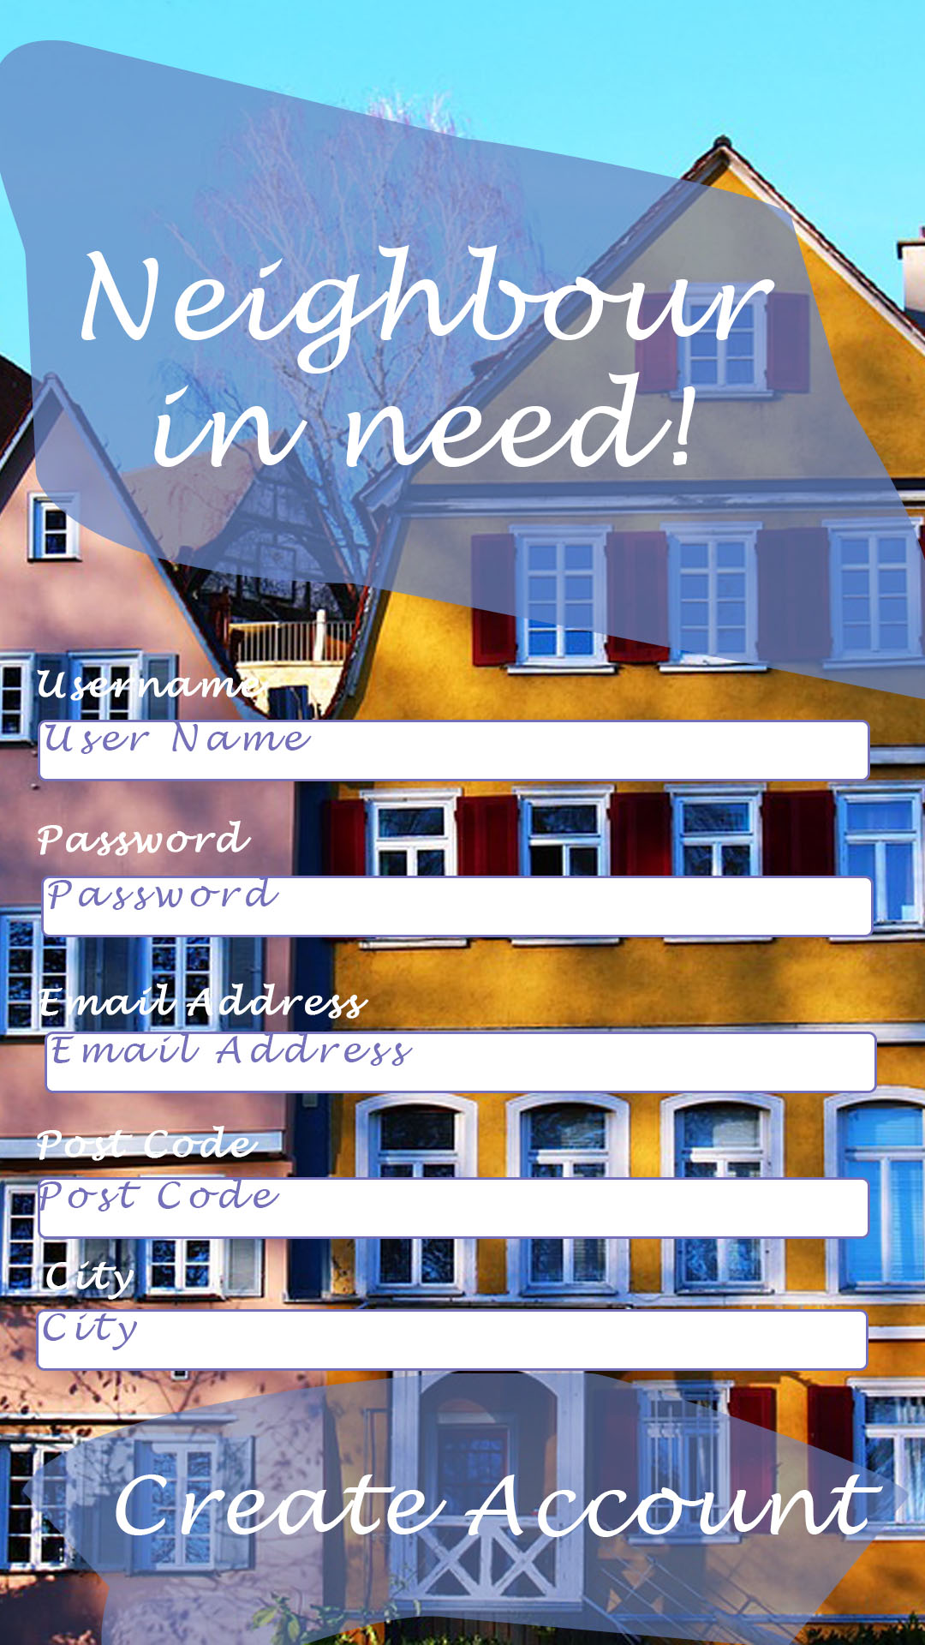

Slide 19

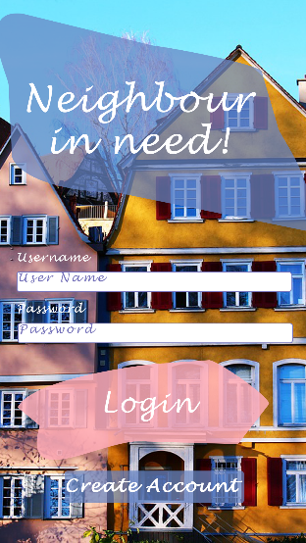

Slide 20
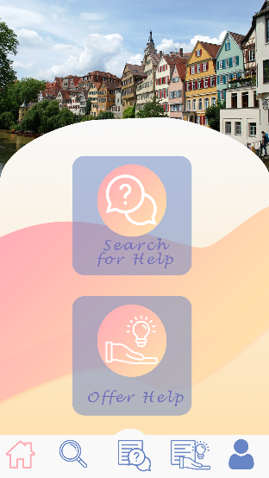



Slide 21
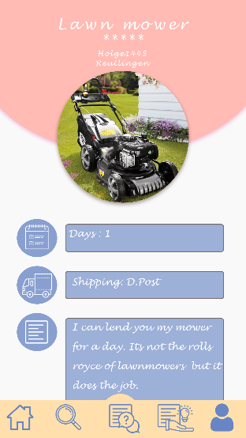

Slide 22
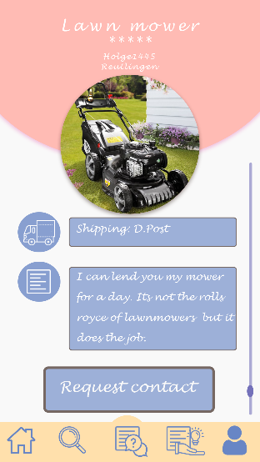
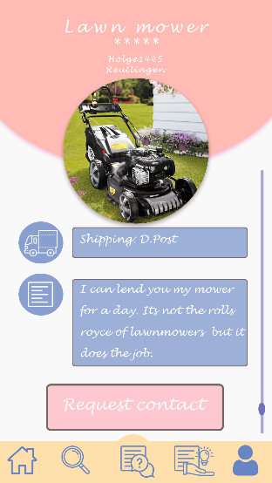
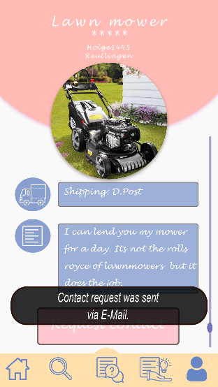

Slide 23

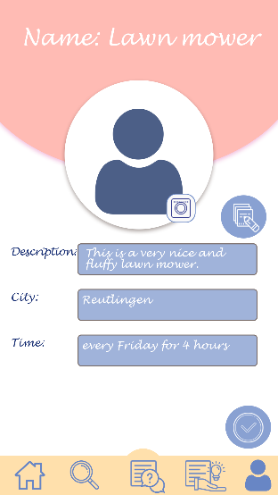

Slide 24
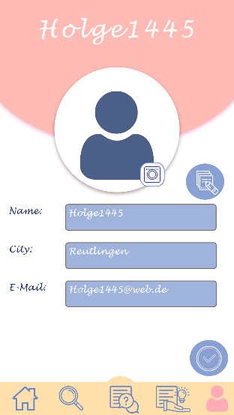
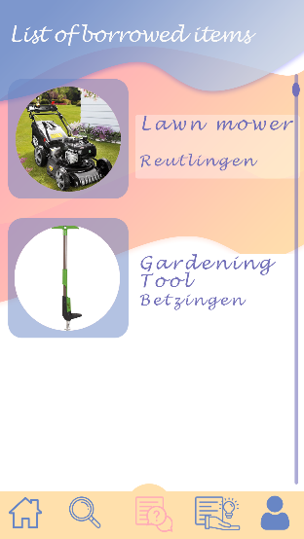
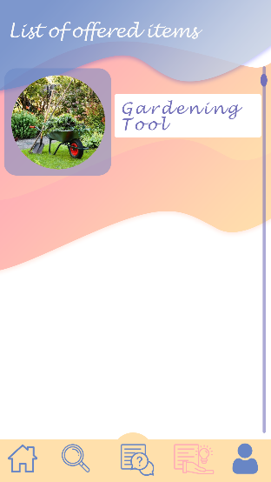



Slide 25
Thank you for your attention!

